Slide 1

HACKING FINAL PROJECT
Detailed Developer Report
Harsh J

Slide 2

SECURITY VULNERABILITIES – AN OVERVIEW
The hacker can steal all the user, seller and admin details in the lifestyle store website (SQL injection).
The hacker can extract the email id of users by their username(IDOR).
The hacker can gain access, modify, update, delete, add the server files and folders. The hacker can also change the source code of the application and add malware,explicit pages,etc.(Shell Upload).
The hacker can inject client side code into the application and change the look of the application to steal their information(XSS).

Slide 3
SECURITY VULNERABILITIES – AN OVERVIEW
The hacker can upload back doors to the web server which gives the hacker access to confidential files and folders without login (Web shell upload).
The password and username for crucial pages are set as their defaults, which makes it easy for hacker to guess the password(Weak passwords).
The hacker can make requests to web server pretending to be the user ,this allows hackers to change passwords and place orders without the knowledge of the victim(CSRF).
The hackers can exploit components that are outdated and are known to have severe vulnerabilities(Components with know vulnerabilities).

Slide 4




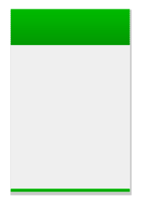
Vulnerability Statistics
Critical
Severe
Moderate
Low
13
9
4
5

Slide 5
Vulnerabilities
No | Severity | Description | Count
1 | Critical | SQL injection | 1
2 | Critical | Weak passwords | 3
3 | Critical | PII Leakage | 2
4 | Moderate | Bruteforce Exploitation | 1
5 | Critical | Insecure file upload | 1
6 | Severe | Reflected XSS | 2
7 | Severe | CSRF | 2
8 | Severe | Stored XSS | 2
9 | Critical | IDOR | 2
10 | Critical | Command Execution Vulnerability | 2
11 | Low | Descriptive error Messages | 1

Slide 6
Vulnerabilities
No | Severity | Description | Count
12 | Critical | Rate Limiting issues | 1
13 | Severe | Forced Browsing | 2
14 | Low | Deafult Files and pages | 4
15 | Moderate | Components with known vulnerabilities | 2
16 | Severe | Open Redirection | 1
17 | Moderate | Client side filter bypass | 1
18 | Critical | Remote File Inclusion | 1

Slide 7

SQL Injection
CRITICAL
Affected URL : http://<IP address>/products.php/?cat=<1 or 2 or 3>
Affected Parameter(s) : cat
Business Impact :
Low Medium High

Slide 8
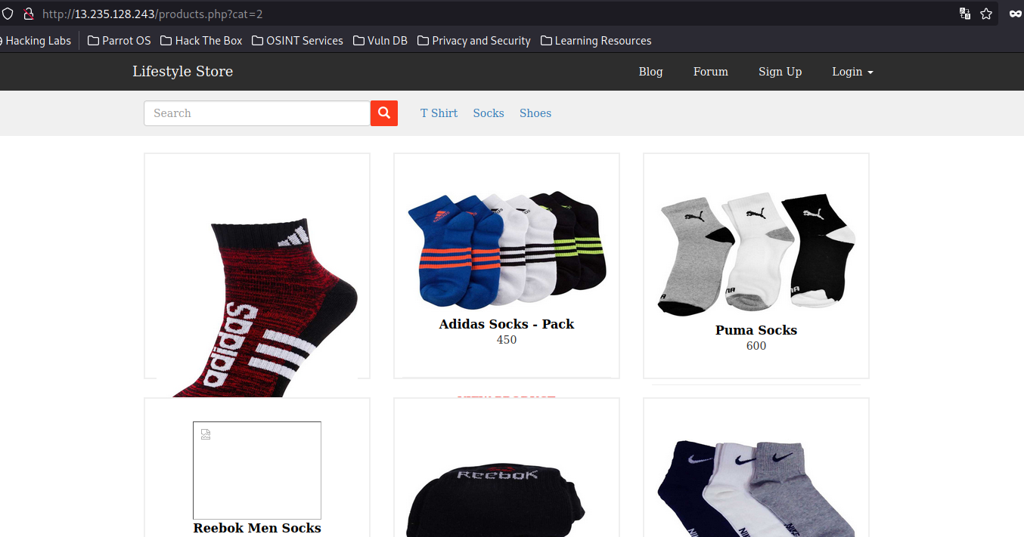
Observation
If we visit the URL we can notice a GET parameter ‘cat’ being passed in the request URL.

Slide 9
Observation
If an apostrophe is added at the end of the ‘cat’ parameter in the URL it returns an error. This means there is a possibility of SQL injection in that place.
Payload : cat = 2’

Slide 10
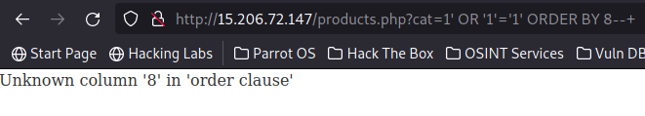
Observation
Finding the number of columns in the webpage for a UNION-based SQL injection.
Payload : cat = 1’ OR ‘1’ = ‘1’ ORDER BY 8--+
Turns out there were 8 columns now that we know the number of columns so we can perform the injection.

Slide 11
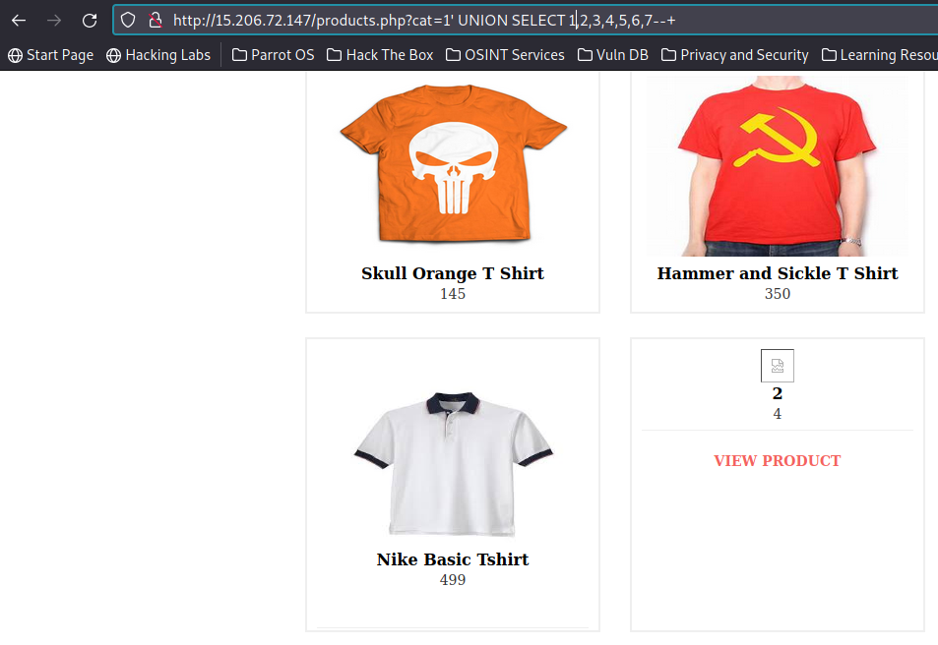
Observation
Injection points were 2 and 4 using the following payload.
Payload : cat = 1’ UNION SELECT 1,2,3,4,5,6,7--+

Slide 12
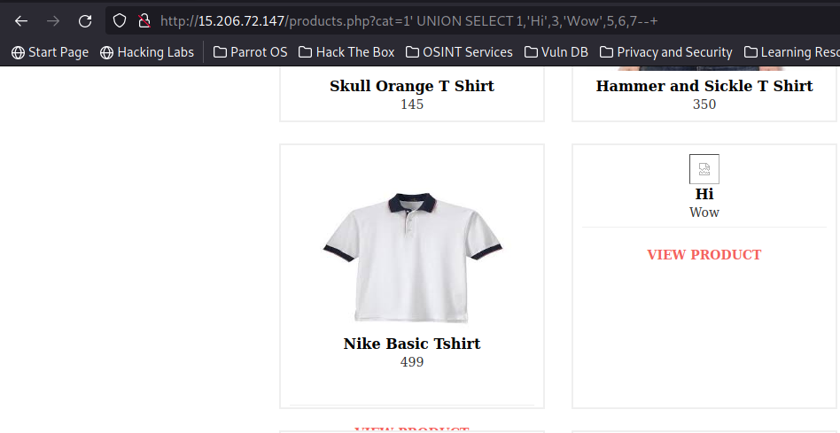
Observation
After finding the injection points we insert two test values to test the injection points.
Payload : cat = 1’ UNION SELECT 1,’Hi’,3,’Wow’,5,6,7--+

Slide 13
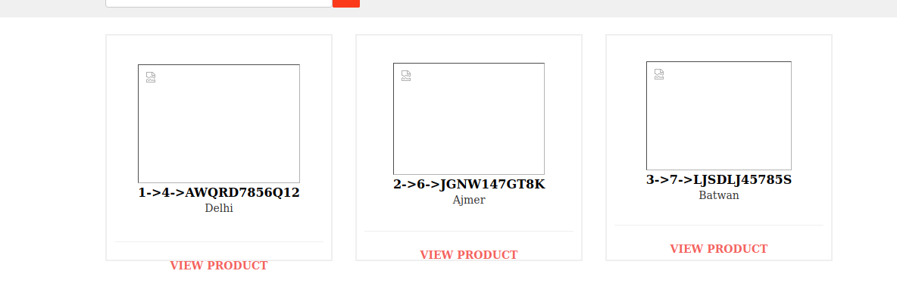
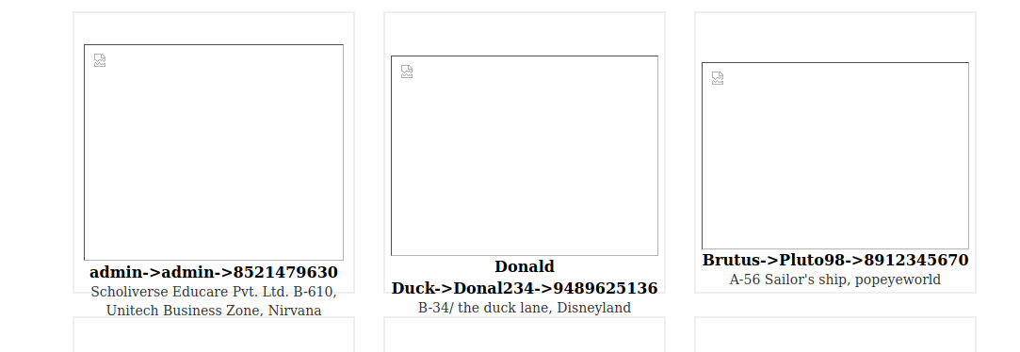
Proof Of Concept
After finding out the injection points were working, we will try to find all the data present in the database.
Payload(For seller) : cat=1’ UNION SELECT 1,CONCAT(id,’->’,user_id,’->’,pan_number),3,city,5,6,7 FROM sellers--+
Payload(For Customers) : cat=1’ UNION SELECT 1,CONCAT(name,’->’,user_name,’->’,phone_number),3,address,5,6,7 FROM sellers--+

Slide 14
Business Impact – Extremely High
The hacker can exploit this vulnerability to extract some crucial customer , seller and product data.
The hacker might be able to get the user accounts and even take control of the admin accounts.
The hacker can gain complete access to the database with the admin panel and can deal massive damage by destroying or modifying the data.
Although the passwords are encrypted they can be misused by the hacker, the hacker may use various tools to crack passwords.

Slide 15
Suggestions
Avoid placing user-provided input directly into SQL statements.
Prefer prepared statements and parameterized queries, which are much safer.
Stored procedures are also usually safer than dynamic SQL.
Properly escape those characters which should be escaped.
Verify that the type of data submitted matches the type expected.
Encrypt private/confidential data being stored in the database.
Salt the encrypted hashes.
This also provides another level of protection just in case an attacker successfully exfiltrates sensitive data.
Implement WAF(Web application Firewall) ,this provides protection to web-facing applications.
WAF can help identify SQL injection attempts.
Based on the setup, WAF can also help prevent SQL injection attempts from reaching the application (and, therefore, the database).
Blacklist all sorts of special character in the URL like ‘ or “ and implement client side checking in order to further improve the server against SQLi.

Slide 16
References
https://www.rapid7.com/fundamentals/sql-injection-attacks/
https://owasp.org/www-community/attacks/SQL_Injection#

Slide 17
Default Admin password(Weak password)
CRITICAL
The below URL has default password for the admin account:
Affected URL : http://IP/ovidentiaCMS/index.php?tg=login&cmd=authform&msg=Connexion&err=&restricted=1
Business Impact:
Low Medium High

Slide 18
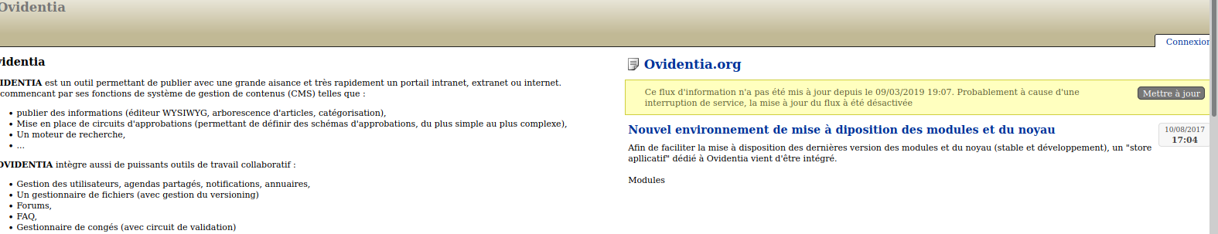
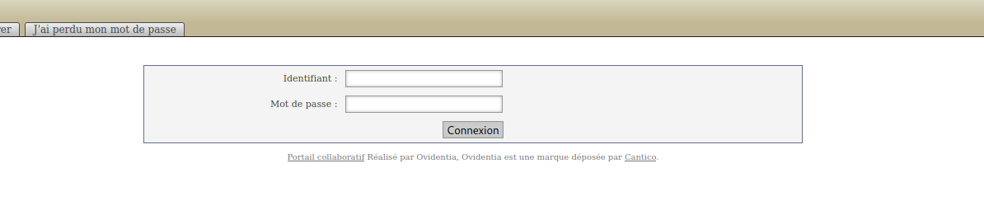
Observation
If we visit the Ovidentia URL(http://IP/ovidentiaCMS/) we notice the ‘connexion’ link which redirects to the admin login page.

Slide 19
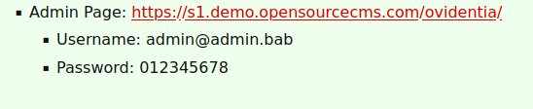
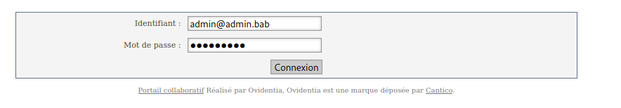
Observation
On doing a little bit of research on the OvidentiaCMS default password in the web this was found.

Slide 20
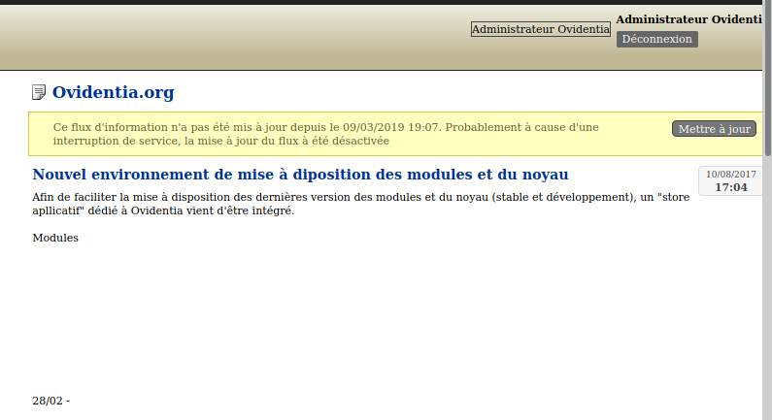
Proof Of Concept
Upon entering the default credential we got the admin dashboard access.

Slide 21
Default Admin password(Weak password)
CRITICAL
Similar URL has weak password for the admin account:
Other Affected URL : http://IP/wondercms/
Business Impact:
Low Medium High

Slide 22
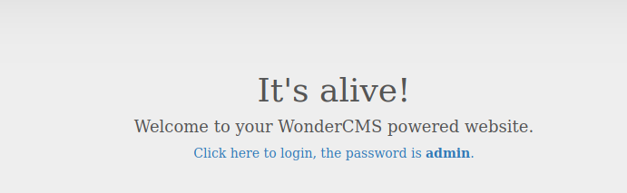
Observation
After entering the WonderCMS URL we land on this page.
We notice that on the page itself the admin password is present.

Slide 23
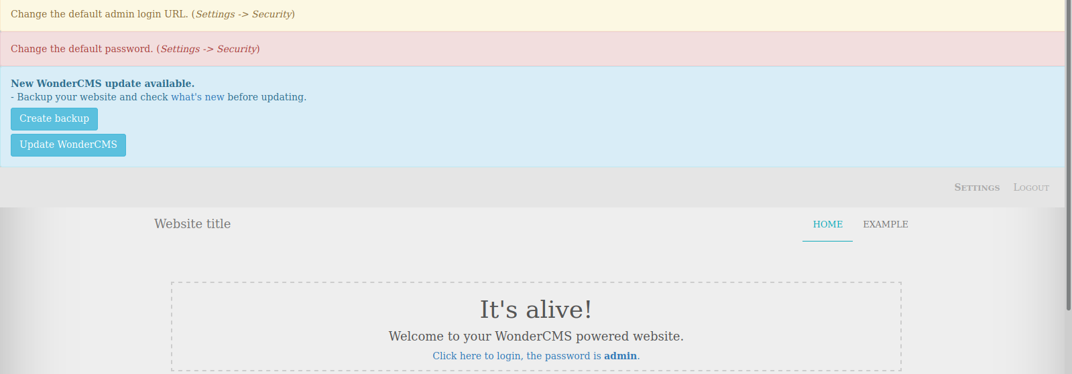
Proof Of Concept
After entering the password, we gain admin access to the blog page where the hacker can further damage the website.

Slide 24
Business Impact – Extremely Critical
The hacker can easily guess the password or find the credentials with a simple web search.
The hacker can gain admin privileges and cause damage to the CMS.
The hacker can also deface the website causing huge loses to the company.

Slide 25
Suggestions
The admin credentials must be changed to something that is not easy to guess and also it must be different from the default password.
Use a password authenticator to automatically generate strong password.
Using really long password with wide range of characters, special characters and numbers would be the best option to avoid bruteforce or dictionary guessing attacks.

Slide 26
References
https://www.cisa.gov/uscert/ncas/alerts/TA13-175A
https://www.computerweekly.com/feature/The-problem-of-passwords-and-how-to-deal-with-it
http://brittlebit.org/security/default-passwords-when-common-are-dangerous-get-rid-of-them-now.html

Slide 27
PII Leakage
CRITICAL
Affected URL : http://13.127.32.100/products/details.php?p_id=<any_number>
Affected field : Seller Info button
Business Impact:
Low Medium High

Slide 28
Observation
Navigate to the URL, we would land in this page .

Slide 29
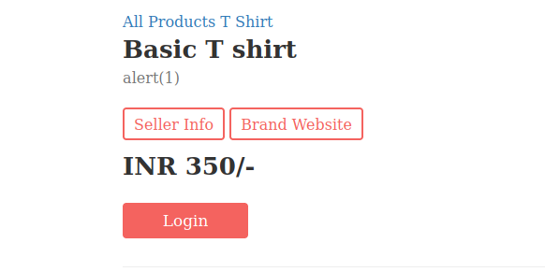
Observation
Click or choose any one of the items .Then we would be redirected to the details of that product. The page would look like this:

Slide 30
Observation
Click on the ‘Seller Info’ button.

Slide 31
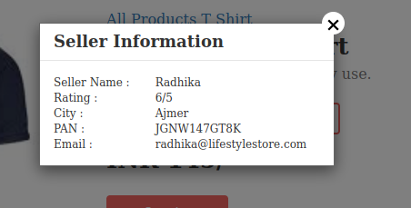
Proof Of Concept
The personal details of the seller are displayed.

Slide 32
Business Impact – Extremely Critical
The hacker can easily extract the seller credentials.
The hacker can misuse the credentials for personal benefit.
The sellers privacy is compromised.

Slide 33
Suggestions
Hide all the crucial and confidential details.
Implement strict testing of the website to check for any information leaks.

Slide 34
References
https://www.geeksforgeeks.org/personally-identifiable-information-leakage-vulnerability/
https://infosecwriteups.com/pii-leakage-via-idor-weak-passwordreset-full-account-takeover-58d159f88d73
http://brittlebit.org/security/default-passwords-when-common-are-dangerous-get-rid-of-them-now.html

Slide 35
Rate Limiting Issue(Bruteforce exploit)
CRITICAL
Affected URL : http://13.232.76.38/reset_password/admin.php
Affected parameter(s) : otp
Business Impact:
Low Medium High

Slide 36
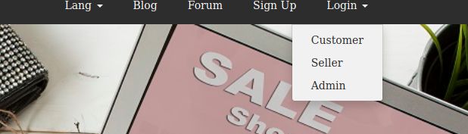
Observation
On the lifestyle store website click on the login dropdown, and click the admin option to login as admin.

Slide 37
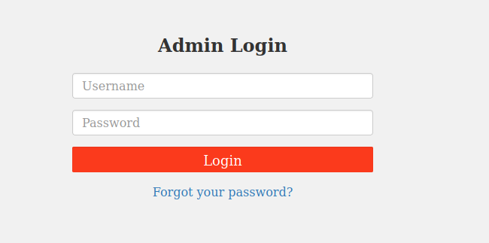
Observation
After clicking on the ‘Admin’ option we will be redirected to this page for admin login , all we need to do is click the forgot password to be redirected to the change password page.

Slide 38
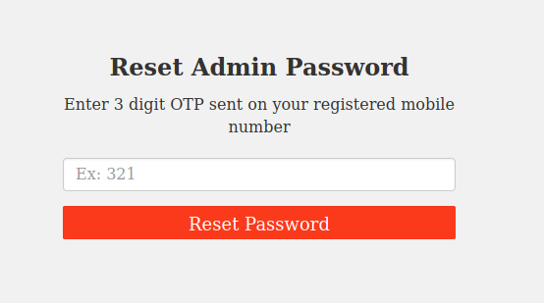
Observation
We will land on this page where we need to enter the OTP. We can easily brute force the 3 digit OTP.

Slide 39
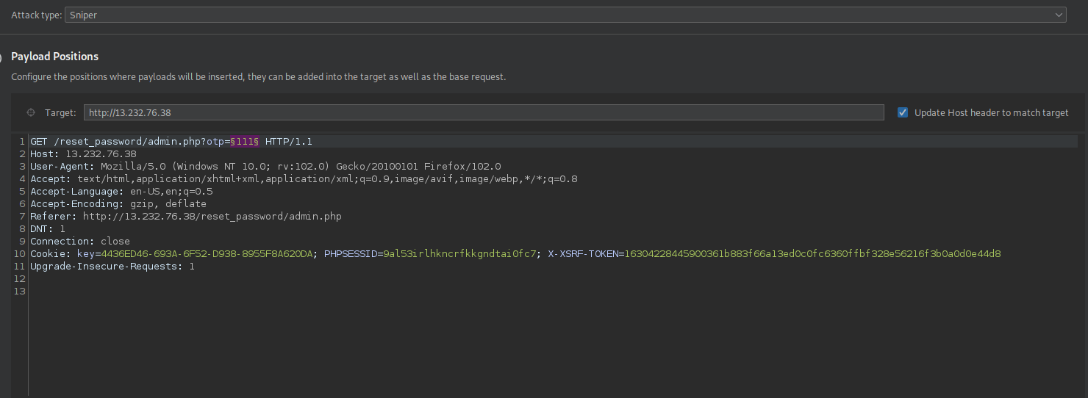
Observation
First enter a random OTP request and intercept the request in Burp suite. We will notice that ‘otp’ parameter is being sent as a GET request to the web server.
We can select the ‘otp’ parameter as the payload position and launch a sniper attack.

Slide 40
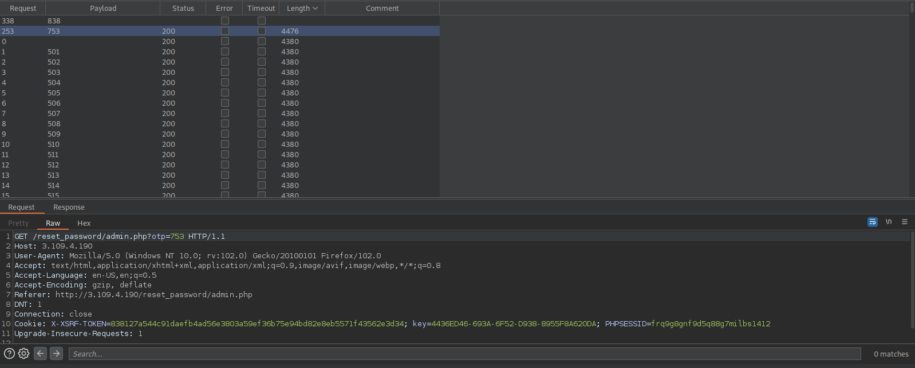
Observation
After doing the bruteforce attack the following is the result:

Slide 41
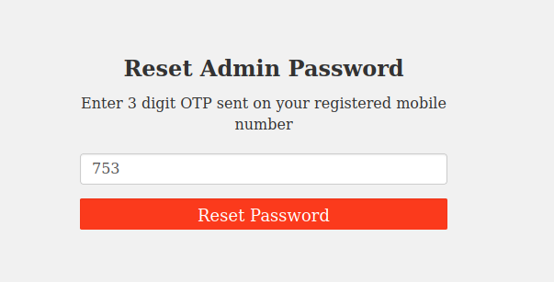
Proof of Concept
We can easily bruteforce the OTP , now we can change the admin password.

Slide 42
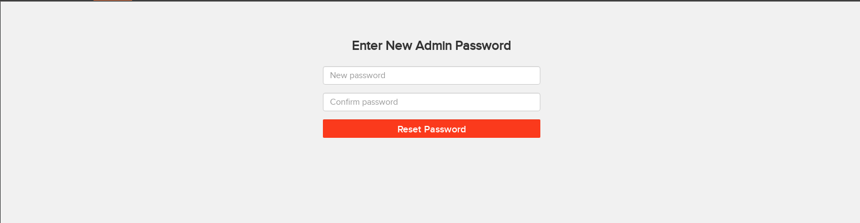
Proof of Concept
Now we can change the password.

Slide 43
Business Impact – Extremely Critical
The hacker can change the admin password.
The hacker can easily gain admin access and privileges and deface the website and also the customers, sellers accounts get compromised leading huge loses to the company.
The hacker might deface the website and damage it too.

Slide 44
Suggestions
We can need to use longer OTP for resetting the admin password as it takes really long time to bruteforce long OTPs.
We can employ other means for resetting the password using multi-factor authentication to verify the user.
We can limit the number of times the browser or client send the OTP to the the web server, and automatically block or stop the client to send the rquest again for some duration.

Slide 45
References
https://www.cloudflare.com/learning/bots/what-is-rate-limiting/
https://en.wikipedia.org/wiki/Rate_limiting
https://www.geeksforgeeks.org/no-rate-limiting-flaw-in-cyber-security/

Slide 46
Bruteforce Exploitation
MODERATE
Affected URL : http://13.232.76.38/cart/cart.php
Affected field(s) : Coupon Code
Business Impact:
Low Medium High

Slide 47
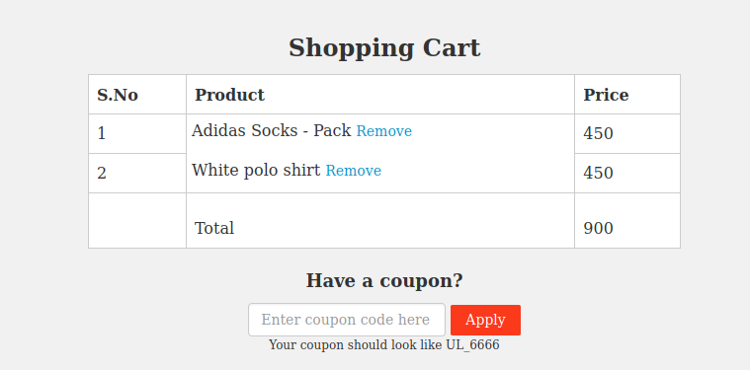
Observation
Navigate to the Lifestylestore page, then login as the customer.
After logging in as the customer , we add some products that we want to buy in the cart.
Then check my cart, we will notice an option to apply the coupon.

Slide 48
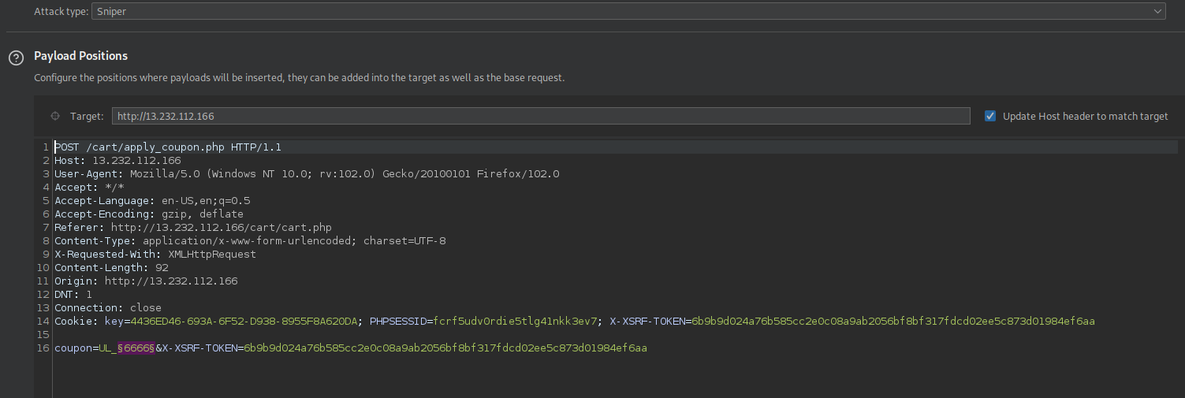
Observation
We now perform a bruteforce attack on the coupon code.
The number in the coupon is used as the payload position and a sniper attack is launched.

Slide 49
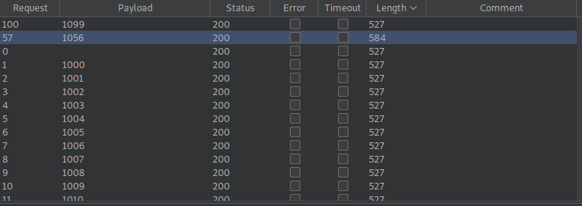
Observation
It appears the coupon code is UL_1056.

Slide 50
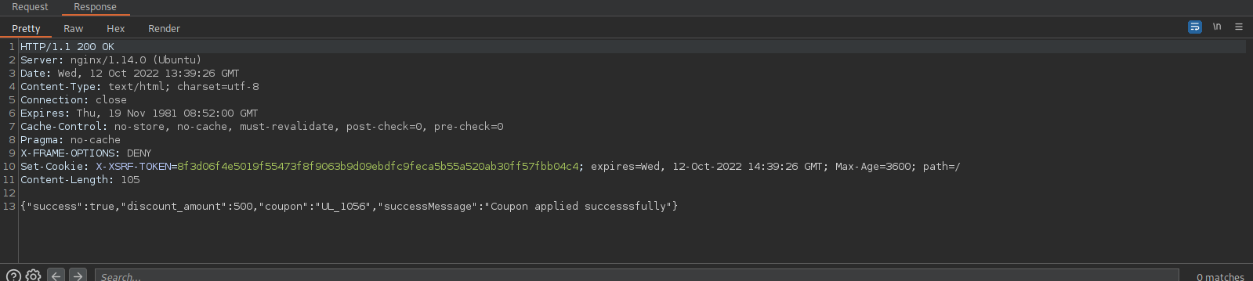
Observation
The response message of applying the coupon code.

Slide 51
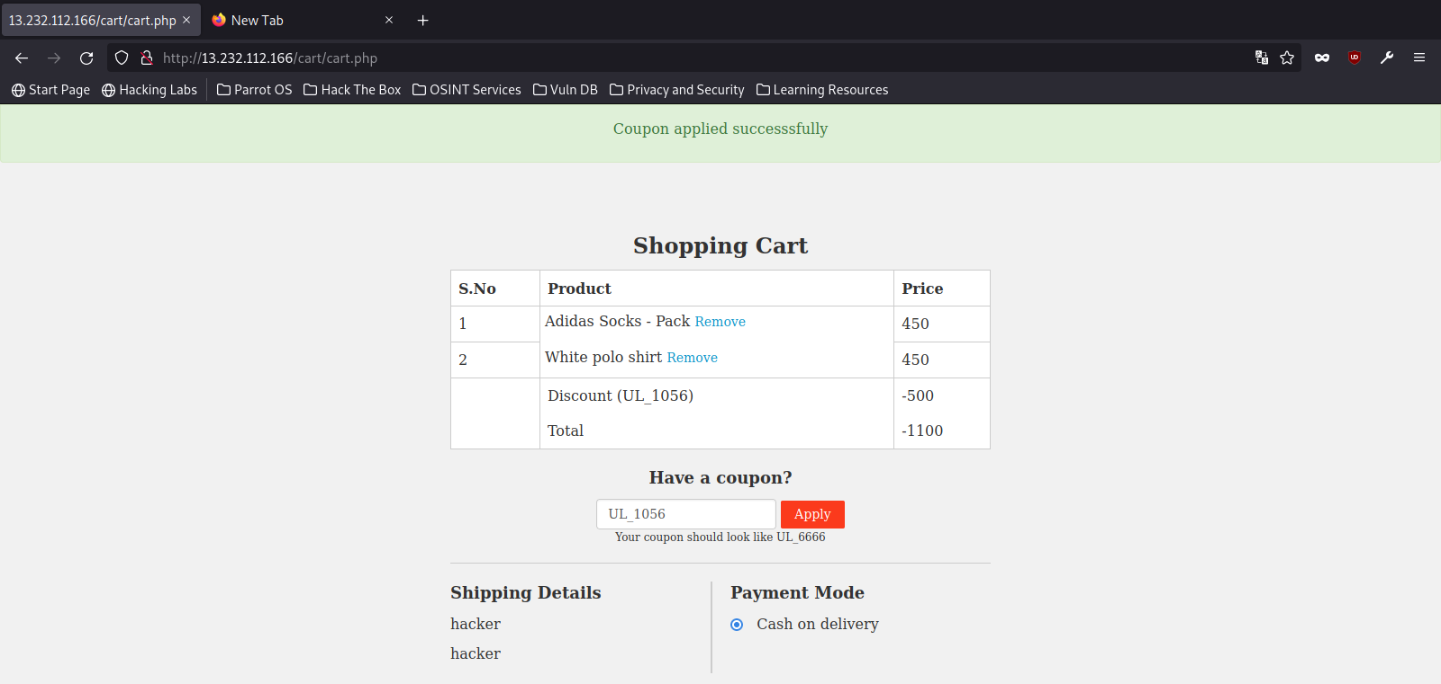
Proof Of Concept - Bruteforce
The coupon code was successfully applied.

Slide 52
Business Impact – Extremely Critical
The hacker can easily bruteforce the coupon code.
This might lead to loss to the company as they can easily buy products at a cheaper cost.

Slide 53
Suggestions
Use coupon codes that are long , which makes it really hard to bruteforce to bruteforce.
Use coupon codes with a wide range of combination of characters, letters, special characters and numbers.
Use rate limiting to restrict the number of requests being sent by the same computer or device.Thereby reducing the chances of bruteforcing.

Slide 54
References
https://www.fortinet.com/resources/cyberglossary/brute-force-attack.
https://www.cloudflare.com/learning/bots/brute-force-attack/
https://en.wikipedia.org/wiki/Brute-force_attack

Slide 55
Insecure File Uploads
SEVERE
Affected URL : http://13.232.76.38/wondercms/home
Affected field(s) : File Upload
Business Impact:
Low Medium High

Slide 56
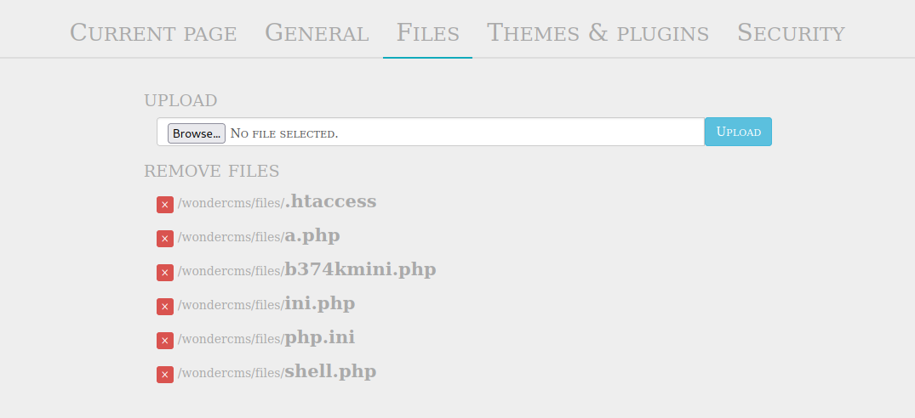
Observation
Navigate to the Lifestylestore page, then enter the Blog page.
Login as admin in the WonderCMS.
After logging in as admin , go to the settings and choose the ‘File’ option in settings.

Slide 57
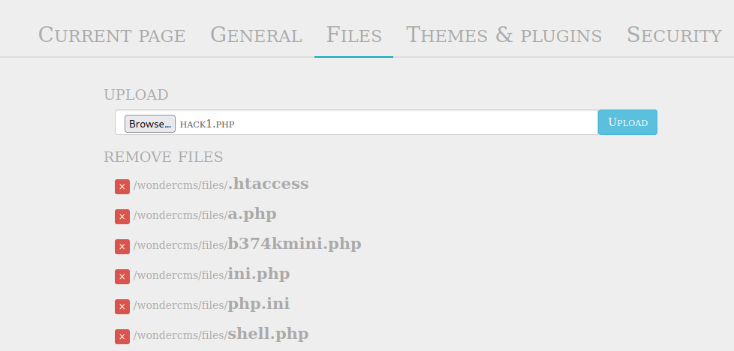
Observation
Here we can upload various malicious files as there is no client side check or server side checks for malicious files, PHP shells , etc. Below we have uploaded a malicious PHP code.

Slide 58
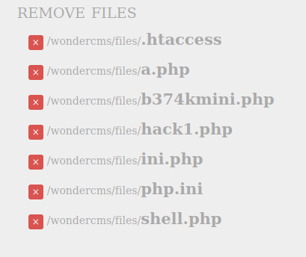
Proof Of Concept
We can click on the malicious PHP file that will be executed. This might lead to the hacker getting to know information about the database and also the data.

Slide 59


Proof Of Concept
The result of executing the PHP scripts.
Hack 1 result:
Hack 2 result:

Slide 60
Business Impact – Extremely High
The hacker can easily upload PHP web shells, hence giving the hacker the ability to gain access to critical information in the server.
The hacker can easily modify, delete, update the server data.
This can severely damage the reputation of the company and the website can be damaged.
The hacker can send spam mail containing malicious links to the company’s employees thereby hacking their accounts as well.
The hacker can upload backdoor , by which the hacker can access the server without logging in.

Slide 61
Suggestions
Apply both client side and server side checks for checking the file extension and file type before uploading it into the server.
Check the server logs often to check for any malicious activity.
Check for any backdoors created by any malicious source in the server.
Maintain backups in order to easily sustain any cyber attack and recover quickly.
Educate the employees on cyber security and the kind of threats they may face, to prevent cyber crime.

Slide 62
References
https://www.offensive-security.com/metasploit-unleashed/file-inclusion-vulnerabilities/
https://beaglesecurity.com/blog/vulnerability/file-inclusion-vulnerabilities.html
https://en.wikipedia.org/wiki/File_inclusion_vulnerability
https://owasp.org/www-project-web-security-testing-guide/v41/4-Web_Application_Security_Testing/07-Input_Validation_Testing/11.1-Testing_for_Local_File_Inclusion

Slide 63
Reflected XSS
SEVERE
Affected URL : http://15.206.82.202/products.php
Affected field(s) : Search Bar
Payload : “>
Business Impact:
Low Medium High

Slide 64
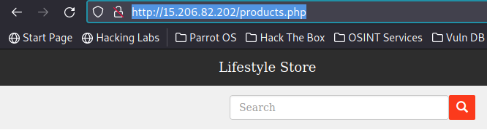
Observation
Navigate to the Lifestylestore page, click on Shop Now.
We will be redirected to the page where all the products are being displayed.
At the top left corner we notice a search bar.

Slide 65
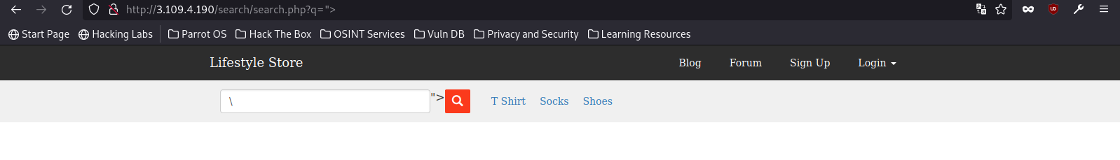
Observation
Now we add the payload in the search bar to test for XSS.
It turns out that the search bar can be used to hack the website using XSS, as we are able to embed our malicious code to the website’s code.
We can notice at the top in the URL that what we serch is being reflected in a GET parameter ‘q’.

Slide 66
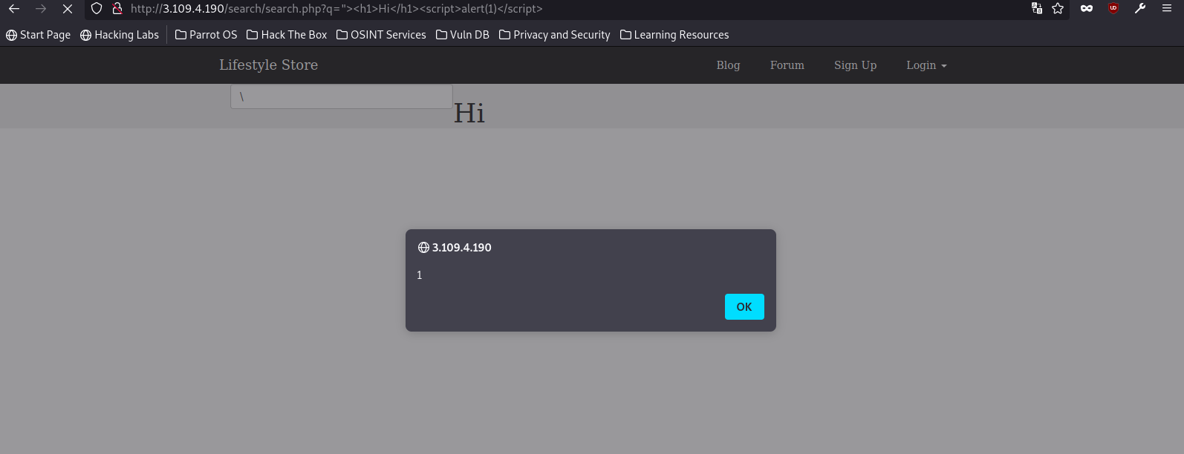
Proof Of Concept
Now we add the malicious javascript payload into the search bar to deface the website or lure the users into clicking malicious links. Which the hacker will take advantage of and steal user details, cookies,etc.
We will now enter malicious script in the GET parameter ‘q’

Slide 67
Business Impact – Extremely High
The hacker can destroy and deface the website.
The hacker can include malicious links, and lure the customers into clicking them. This might lead to compromise of customer data and cookies. The hacker can easily extract Personally Identifiable Information of customer and seller.
The hacker can pretend to be someone else.

Slide 68
Suggestions
Apply filters in the client side and server side.
These filters blacklist all the special characters like - <>, “” ,”script” word,’’,etc. Which have special meaning to code, i.e. input validation.
Using Web Applicaion firewall prevents XSS attacks.
Carefully configure Content-Security-Policy Headers

Slide 69
References
https://www.invicti.com/blog/web-security/reflected-xss-attack/
https://portswigger.net/web-security/cross-site-scripting
https://snyk.io/learn/cross-site-scripting/

Slide 70
Component With known Vulnerabilities
MODERATE
Affected URL(s) : http://15.206.82.202/wondercms, ,http://15.206.82.202/forum/
Affected components(s) : WonderCMS and Codologic
Business Impact:
Low Medium High

Slide 71


Observation
For Wonder CMS:
Navigate to wondercms page of Lifestyle store and log in as admin.
After logging in click on settings option.
At the bottom left of settings we will notice the version of WonderCMS.
For Codologic Forum:
Navigate to lifestyle store webpage and then click on forums.
At the bottom we will notice the version of codologic forum.

Slide 72
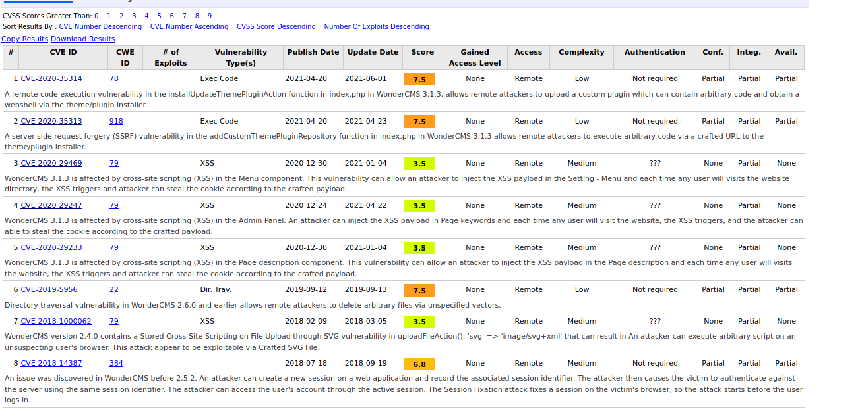
Proof Of Concept(WonderCMS)
If we do a simple search on the vulnerabilty database or in Google for WonderCMS v2.3.1 vulnerabilities we will find a ton of vulnerabilities along with their exploits.
URL : https://www.cvedetails.com/vulnerability-list/vendor_id-15088/Wondercms.html

Slide 73
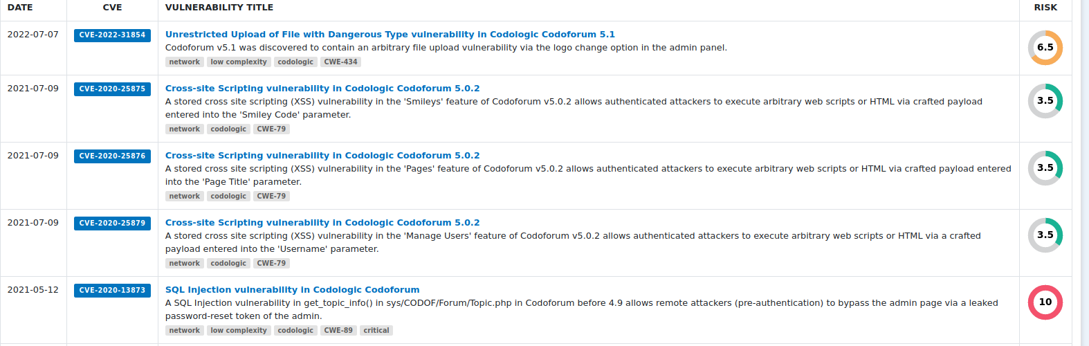
Proof Of Concept(CodoForum)
If we do a simple search on the vulnerabilty database or in Google for Codologic Vulnerabilities we will find a ton of vulnerabilities along with their exploits.
URL : https://cyber.vumetric.com/vulns/codologic/

Slide 74
Business Impact – Moderate
The hacker can easily exploit any of these components to hack the website and extract critical user data.
The hacker can easily extract admin passwords. And take full control of wonderCMS and codologic forum.
The hacker can socially hack the users of the forum.

Slide 75
Suggestions
Use latest components that are available.
Update and patch the components as and when the updates are released.
Avoid using outdated components or components with many known exploits.

Slide 76
References
https://owasp.org/www-project-top-ten/2017/A9_2017-Using_Components_with_Known_Vulnerabilities
https://www.geeksforgeeks.org/what-is-components-with-known-vulnerability/
https://www.omnicybersecurity.com/using-components-with-known-vulnerabilities/

Slide 77
Stored XSS
SEVERE
Affected URL : http://15.206.82.202/wondercms
Affected field(s) : Admin settings – Current Page, General
Payload : “Hacked”>”
Business Impact:
Low Medium High

Slide 78
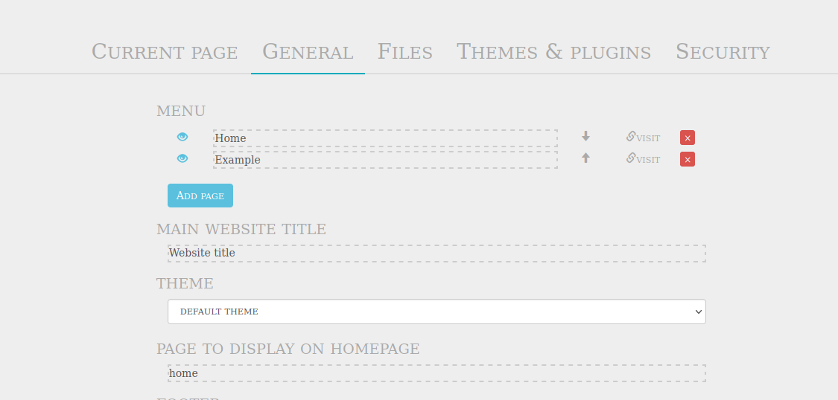
Observation(Menu)
Navigate to wondercms page of Lifestyle store and log in as admin.
After logging in click on settings and choose the ‘General’ option.
We will presented with a content like this.

Slide 79
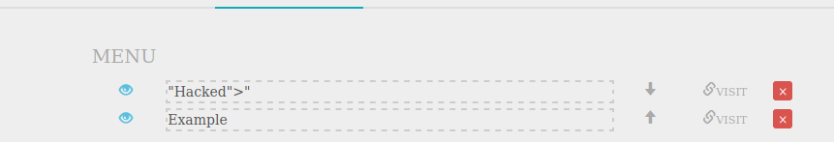
Observation(Menu)
If we notice the components with known vulnerability section , we know that this version of WonderCMS has two places or points where XSS can be done. One is the ‘Menu’ area and other is the ‘Page Title’ and ‘Page Description’ area.
Below I have added the malicious payload to the Menu area.

Slide 80
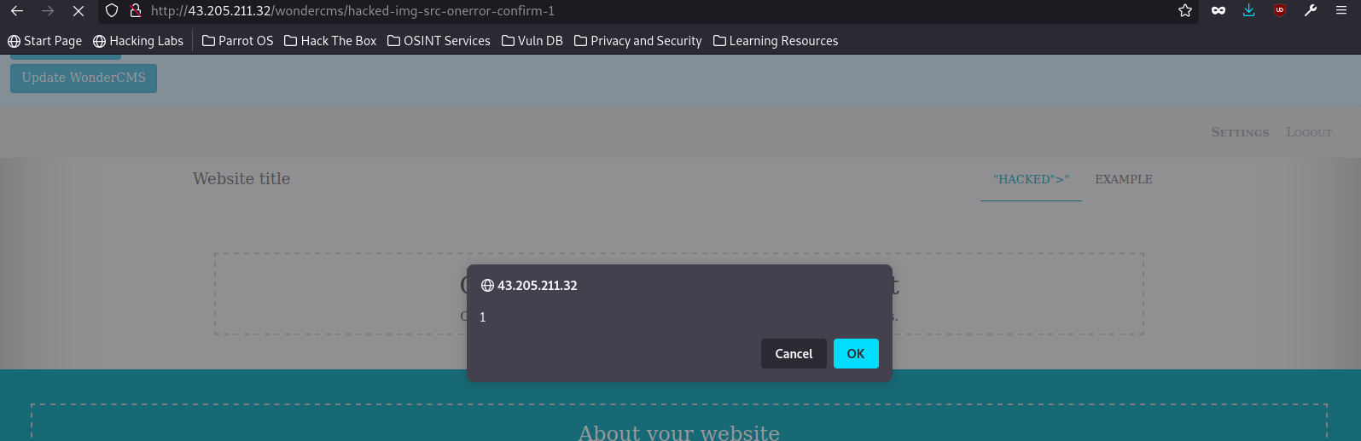
Proof Of Concept(Menu)
The result of this adding this payload is shown in the below picture.

Slide 81
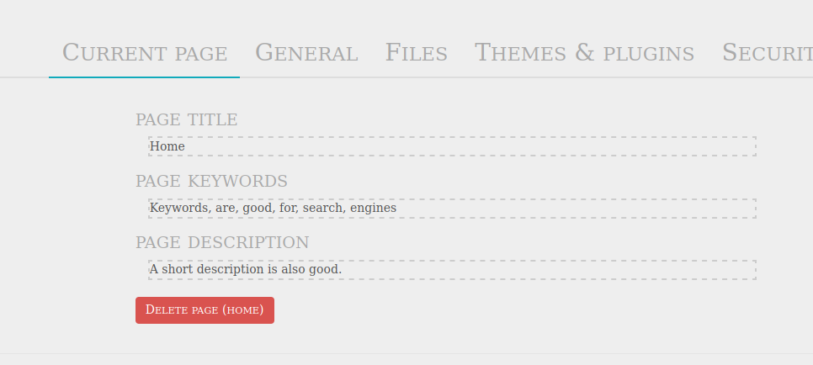
Observation(Page title and Description)
Navigate to wondercms page of Lifestyle store and log in as admin.
After logging in click on settings and choose the ‘Current Page’ option.
We will presented with a content like this.

Slide 82
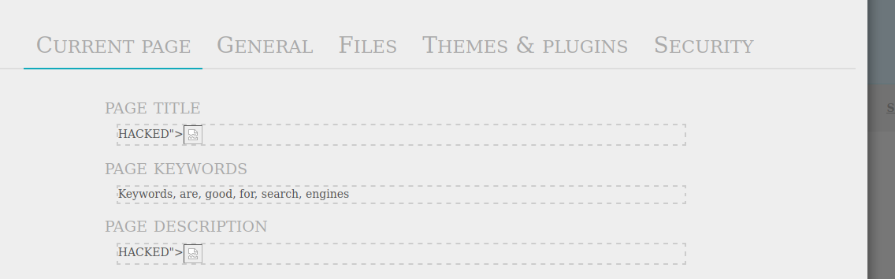
Observation(Page title and Description)
In the Page title and description area of ‘General Page’ settings I have added the malicious code.
Below is the image of the malicious payload added.

Slide 83
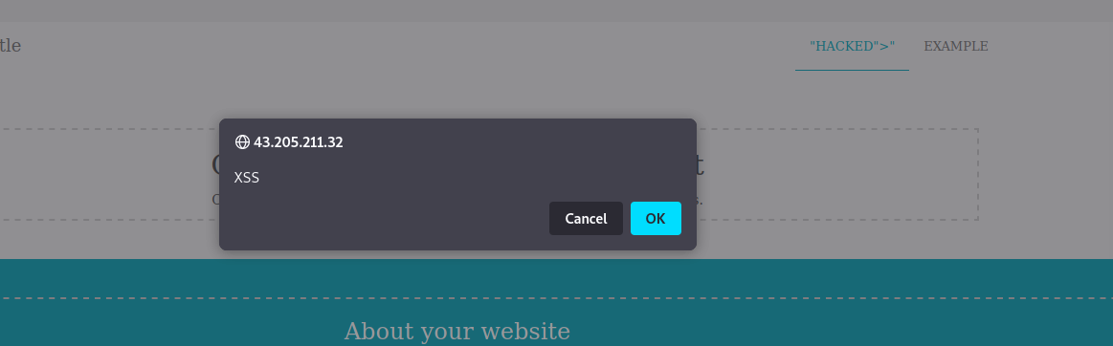
Proof Of Concept(Page title and Description)
The output of that malicious payload is this:

Slide 84
Stored XSS
SEVERE
Other instances:-
Affected URL : http://43.205.125.215/products/details.php?p_id=
Affected field(s) : Reviews field
Payload : <script>alert(1)</script>
Business Impact:
Low Medium High

Slide 85
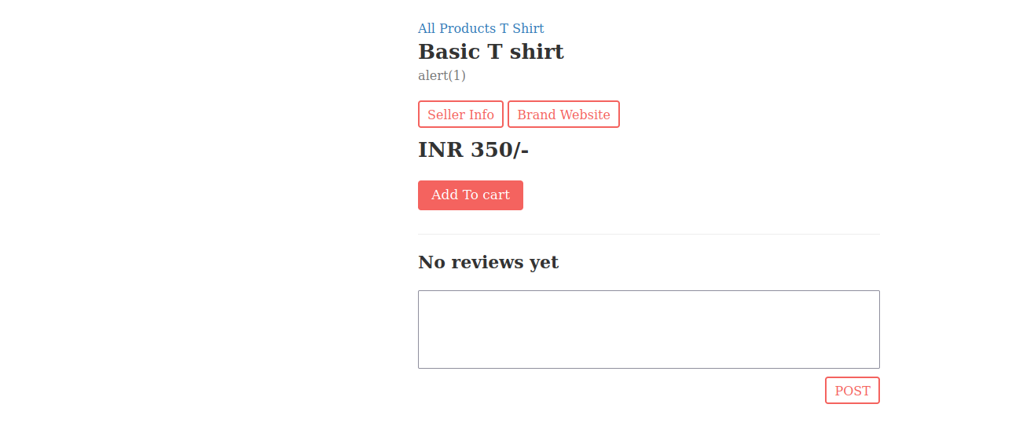
Observation
Navigate to Lifestyle store , login as customer and click on ‘Shop Now’.
We will be redirected to a page with all the products.
If we click on ‘View Product’ of a product we will come to a page as shown below:

Slide 86
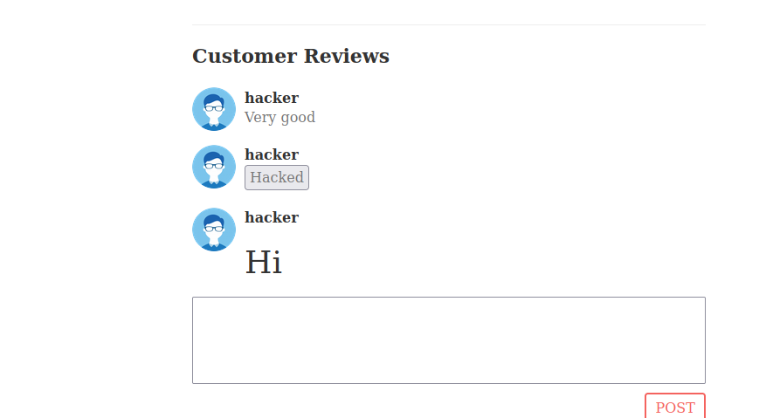
Observation
In this Post Reviews text box we can enter our malicious XSS payload that will be displayed to all the customers. If we click the hacked button a popup appears as shown in next slide.

Slide 87
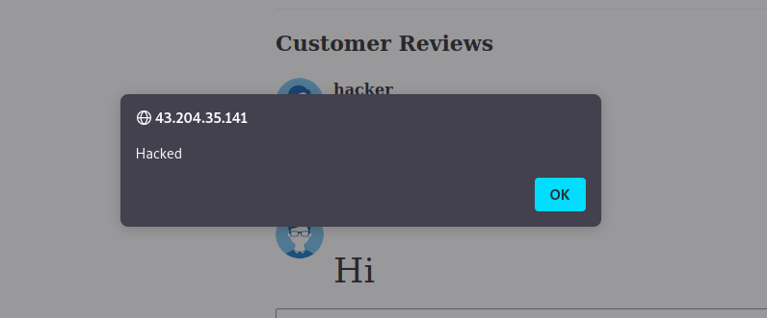
Proof Of Concept
After clicking the hacked button on the previous slide we will notice this popup.

Slide 88
Business Impact – Extremely High
The hacker can easily exploit any of these components to hack the website and extract critical user data.
The hacker can easily extract admin passwords. And take full control of the website.
The hacker can lure the customer to click malicious link that can be used for malicious intents.
The hacker can impersonate other users by stealing user cookies.
The hacker can deface te website.
Prevent the user from typing any HTML code in the Review section and check before posting the review for nay special tags or characters.
The hacker can threaten the customers , making the company lose many customers.

Slide 89
Suggestions
Perform input validation on the server side and the client side.
Whitelist special characters with special meaning to prevent XSS attacks.
Filter out all special scripts that are coming from an external source.
Mitigate XSS using Content Security Policy(CSP).
Encode data on output.

Slide 90
References
https://brightsec.com/blog/stored-xss/
https://www.geeksforgeeks.org/cross-site-scripting-xss-prevention-techniques/
https://crashtest-security.com/stored-xss-attack/

Slide 91
Cross Site Request Forgery
SEVERE
Affected URL : http://13.233.138.0/profile/change_password.php
Affected field(s) : New password field
Business Impact:
Low Medium High

Slide 92
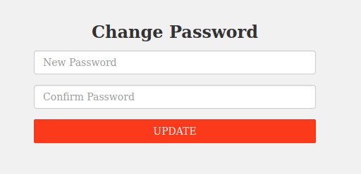
Observation
Navigate to Lifestyle store , login as customer and go to your profile.
Click on change password.
We will land on this page:

Slide 93
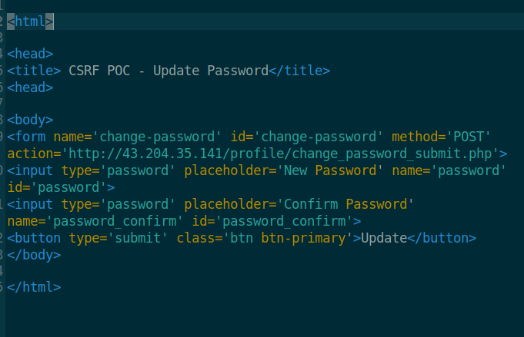
Observation
Below is the CSRF exploit code:

Slide 94
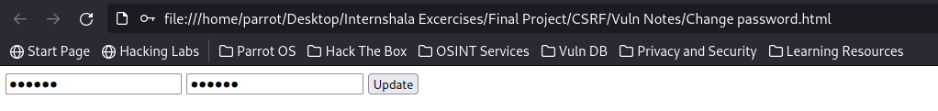
Proof Of Concept
Opening the CSRF exploit on the same browser as the Lifestyle store we get the below page.
We can change the password and click on update to update the profile password.

Slide 95
Cross Site Request Forgery
SEVERE
Affected URL : http://13.233.138.0/cart/cart.php
Affected field(s) : Place Order
Business Impact:
Low Medium High

Slide 96
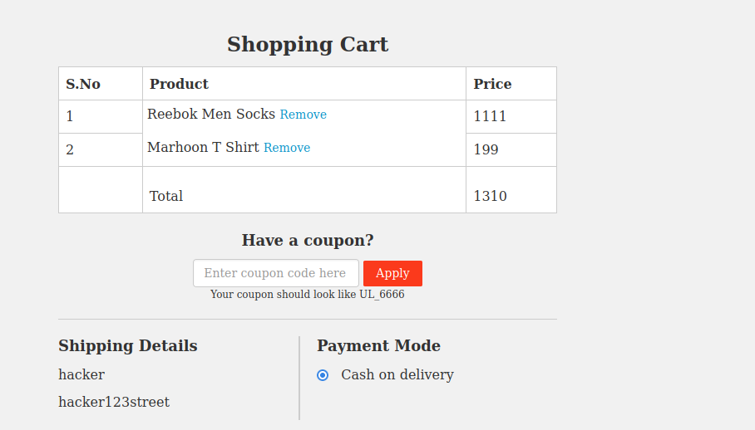
Observation
Navigate to Lifestyle store , login as customer and go to your cart.
We will land on this page:

Slide 97
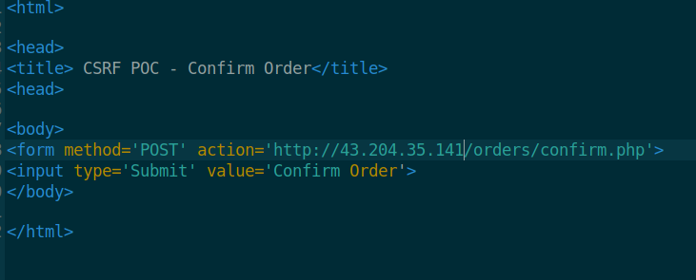
Observation
We can place orders using the below CSRF exploit code:

Slide 98

Observation
Opening the CSRF exploit on the same browser as the Lifestyle store we get the below page.
We can place the order for the items in the cart by clicking the button in the CSRF page.

Slide 99

Proof Of Concept
After clicking on confirm order we get the receipt of the order that has been placed.

Slide 100
Business Impact – Extremely High
The hacker can send request like – Change password or Password on behalf of the user.
The hacker can hack the customers account.
The hacker can cause severe damage to the reputation of the company and the company may lose customers due to CSRF attacks.
The hacker can hijack web session of the customer.

Slide 101
Suggestions
Perform input validation on the server side and the client side.
Whitelist special characters with special meaning to prevent XSS attacks.
Filter out all special scripts that are coming from an external source.
Use Anti-CSRF tokens to avoid or prevent CSRF attacks.
Implement two factor authentication.
Regularly test web apps.

Slide 102
References
https://learn.microsoft.com/en-us/aspnet/web-api/overview/security/preventing-cross-site-request-forgery-csrf-attacksk/
https://www.makeuseof.com/what-are-csrf-attacks-and-how-can-you-prevent-them/
https://brightsec.com/blog/cross-site-request-forgery-csrf/
https://cheatsheetseries.owasp.org/cheatsheets/Cross-Site_Request_Forgery_Prevention_Cheat_Sheet.html

Slide 103
Insecure Direct Object Reference
SEVERE
Affected URL : http://13.233.138.0/orders/orders.php?customer=16
Affected parameter(s) : customer
Business Impact:
Low Medium High

Slide 104

Observation
Navigate to Lifestyle store , login as customer and go to your order list.
We will land on a page like this:
We observe that the Customer ID is also being displayed in the URL,i.e. 3.

Slide 105

Proof Of Concept
Lets change the Customer ID and see if we can view the orders of other customers.Below I have change ‘customer’ parameter value to 5.

Slide 106

Proof Of Concept
Similarly I can do this for other customers too.

Slide 107
Insecure Direct Object Reference
SEVERE
Affected URL : http://13.233.138.0/forum/index.php?u=/user/profile/5#
Affected paramer(s) : u
Business Impact:
Low Medium High

Slide 108

Observation
Navigate to Lifestyle Store and enter the forum section.
In the forums , sign up and login to the account.
Go to your profile we can notice that the URL has our profile ID, i.e Profile Id -> 5.

Slide 109

Proof Of Concept
Lets see we can access other user’s profiles by just changing the profile ID number in the URL.

Slide 110

Proof Of Concept
Other user’s profile.

Slide 111
Business Impact – Extremely High
The hacker can inadvertently access other users profile in the codologic forum page.
The hacker can view all the messages of that particular user and also gain personal information like phone number, email address and residence address being displayed on the user’s profile or on the customer’s order list.
The hacker can socially hack the customers.
The hackers can post messages in the forum pretending to be the user.

Slide 112
Suggestions
Randomly assign numbers to reference objects.
Using Universally Unique Identifiers(UUIDs).
Perform access validation.
Perform parameter verification.

Slide 113
References
https://www.eccouncil.org/cybersecurity-exchange/web-application-hacking/idor-vulnerability-detection-prevention/
https://www.geeksforgeeks.org/insecure-direct-object-reference-idor-vulnerability/
https://cheatsheetseries.owasp.org/cheatsheets/Insecure_Direct_Object_Reference_Prevention_Cheat_Sheet.html

Slide 114
Command Execution Vulnerability
CRITICAL
Affected URL : http://13.232.76.38/wondercms/home
http://13.232.76.38/admin31/console.php
Business Impact :
Low Medium High

Slide 115

Observation
Navigate to Lifestyle Store and login as the admin.
We can easily change the Password of admin using bruteforcing the OTP as shown in the previous slides.
We will get access to the admin page where we will notice a console button to get access to console of admin

Slide 116


Proof Of Concept
In this console we can enter our commands and get valuable server information.

Slide 117
Observation
Navigate to Lifestyle Store and go to the Blog page.
Login as the admin and go to settings.
The move to the ‘Files’ section and click on the mini shell PHP file.

Slide 118

Proof Of Concept
We will be able to access the shell and in this mini shell we can enter commands.

Slide 119
Business Impact – Extremely Critical
The hacker can not only get access to critical files , the hacker can extract crucial information about the server, the programming language used, database , etc .
This might also lead to leakage of customer information.
The hacker can get remote access to the database admin page.
The hacker can execute malicious commands on the server.

Slide 120
Suggestions
Check the server often for backdoors.
Perform input validation , and blacklist all special commands and characters.
Encrypt the files and in the server using a safe encryption algorithm, so even if hacker breaks in ,the hacker cannot read the files.

Slide 121
References
https://www.secpoint.com/what-is-a-remote-command-execution-vulnerability.html
https://resources.infosecinstitute.com/topic/what-are-command-injection-vulnerabilities/
https://en.wikipedia.org/wiki/Arbitrary_code_execution

Slide 122
Default files and pages
LOW
Affected URL : http://13.233.138.0/
Business Impact :
Low Medium High

Slide 123

Proof Of Concept – /robots.txt
Navigate to Lifestyle Store and add robots.txt to the end of the URL.
We notice that the default files and pages are being displayd, these files may contain crucial information

Slide 124

Proof Of Concept – /static/images
If we enter the URL and add /static/images(http://IP/static/images).
We get a list of all the images that are used in our e-commerce site.

Slide 125

Proof Of Concept – /userlist.txt
A simple dirbuster scan for txt files in the Lifestyle store domain led to the discoverance of a text file called /userlist.txt.
If we add /userlist.txt to end of URL we get the list of users of Lifestyle store.

Slide 126

Proof Of Concept – /server-status
When performing the command execution vulnerability , we found out that the domain uses PHP as its programming language.
So adding the /server-status to the end of URL we get this.

Slide 127
Business Impact – Low
The hacker gains critical information about the server and it gives the hacker knowledge on how and where to perform the exploits.
The website is not directly harmed.

Slide 128
Suggestions
The developer should delete or block the default configuration files , from being viewed in the world wide web.

Slide 129
References
https://thwack.solarwinds.com/resources/thwack-command-center/f/forum/38738/apache-tomcat-default-files-medium-vulnerability
https://www.acunetix.com/vulnerabilities/web/apache-tomcat-sample-files/

Slide 130
Client Side Filter Bypass
MODERATE
Affected URL : http://13.126.34.117/profile/16/edit/
Business Impact:
Low Medium High

Slide 131

Observation
Navigate to Lifestyle Store and login as the customer.
After logging in , go to your profile and click ‘Edit Profile’ Button to go to edit profile page.
We will land on a page that looks like this:

Slide 132
Observation
We observe that the only parameter we can edit in our profile are username, phone number and name.

Slide 133

Observation
So, lets try intercepting the update request using Burp Suite after clicking the update button and see if we can modify any of the fields.
After clicking update the following request is generated:

Slide 134

Observation
Modifying the phone number or the ‘contact’ field.

Slide 135

Proof Of Concept
We successfully intercepted and entered an invalid phone number , thereby bypassing the client.

Slide 136
Business Impact – Moderate
This vulnerability would trouble the customers and sellers.
This might lead to a loss of the company’s customers.

Slide 137
Suggestions
Implement both server and client side checks.

Slide 138
References
https://www.geeksforgeeks.org/what-is-client-side-filter-bypass/
https://owasp.org/www-project-top-10-client-side-security-risks/

Slide 139
Descriptive Error Messages
LOW
Affected URL : http://13.126.34.117/?includelang=lang/fr.php
Affected parameter : includelang
Business Impact :
Low Medium High

Slide 140

Observation
Navigate to Lifestyle Store and click the ‘Lang’ dropdown and choose a language. Lets choose any of the two.

Slide 141

Observation
We will notice the URL contains a GET parameter ‘includelang’.

Slide 142

Proof Of Concept
If we modify the GET parameter ‘includelang’ with some invalid values we get a descriptive rror message.
Payload: URL?includelang=hello

Slide 143
Business Impact – Low
This vulnerability might lead to leakage of server information and its details via the error messages.
This vulnerability directly does not impact the Business nor the website.

Slide 144
Suggestions
Perform input sanitization.
Do not display errors to the users.
Do not display debug information on the actual website.

Slide 145
References
https://cwe.mitre.org/data/definitions/209.html/
https://www.getastra.com/blog/knowledge-base/server-error-messages-prevention/

Slide 146
Remote File Inclusion
Critical
Affected URL : http://13.126.34.117/?includelang=lang/fr.php
Affected parameter : includelang
Business Impact :
Low Medium High

Slide 147
Observation
Navigate to Lifestyle Store and click the ‘Lang’ dropdown and choose a language. Lets choose any of the two.

Slide 148
Observation
We will notice the URL contains a GET parameter ‘includelang’.

Slide 149

Observation
In the ‘includelang’ parameter we enter the payload.
Payload: URL?includelang=/etc/passwd
On executing this we file get the username.

Slide 150

Proof Of Concept
The hacker can upload malicious files and malware in the ‘includelang’ parameter. The hacker can upload backdoors to have direct access to the server.

Slide 151
Business Impact – Extremely Critical
The attacker can upload malicious scripts.
The attacker can upload malware from a remote URL from a different domain.
The attacker can execute commands.
The attacker can gain access to sub-domains of that website

Slide 152
Suggestions
Perform input sanitization.
Use a corresponding identifier and not the actual name, to access the file.

Slide 153
References
https://www.acunetix.com/blog/articles/remote-file-inclusion-rfi/
https://owasp.org/www-project-web-security-testing-guide/v42/4-Web_Application_Security_Testing/07-Input_Validation_Testing/11.2-Testing_for_Remote_File_Inclusion
https://en.wikipedia.org/wiki/File_inclusion_vulnerability

Slide 154
Forced Browsing
SEVERE
Affected URL : http://13.126.34.117/
Forced URL(s) : http://13.126.34.117/admin31/dashboard.php
http://13.126.34.117/admin31/console.php
Business Impact:
Low Medium High

Slide 155

Observation
Navigate to the Lifestylestore page, then login as the customer.
Now forcefully type the URL – http://13.126.34.117/admin31/dashboard.php to go to the admin dashboard.

Slide 156

Proof Of Concept
We get access to the admin dashboard, by just entering its URL.

Slide 157

Observation
Navigate to the Lifestylestore page, then login as the customer.
Similarly, forcefully type the URL – http://13.126.34.117/admin31/console.php to go to the admin console.

Slide 158

Proof Of Concept
We get access to the admin console too, by just entering its URL.

Slide 159
Business Impact – High
The attacker can run malicious commands.
The hacker can extract private information.
The attacker can edit all the items and sellers.

Slide 160
Suggestions
Server side security checks must be done properly.
Make the admin URL long and not guessable.

Slide 161
References
https://owasp.org/www-community/attacks/Forced_browsing
https://www.acunetix.com/blog/web-security-zone/what-is-forced-browsing/
https://www.wallarm.com/what/forced-browsing-attack

Slide 162
Open Redirection
SEVERE
Affected URL :http://13.126.34.117/redirect.php?url=www.chandanstore.com
Affected Parameter(s) : url
Business Impact:
Low Medium High

Slide 163

Observation
Navigate to the Lifestylestore page, then login as the customer.
The start shopping and choose an item.
After choosing an item click on the brand’s website button to get redirected to seller’s website.

Slide 164

Observation
We will be redirected , and if we notice the URL we will notice a GET parameter ‘url’ containing the address of the brand’s website.
If we add the following payload to the ‘url’ parameter:
Payload: URL?url=https://www.google.com

Slide 165

Observation
Entering the URL of google in the ‘url’ parameter.

Slide 166

Proof Of Concept
We will be redirected to Google’s Page.

Slide 167
Business Impact – High
The attacker can redirect to page to some phishing or malicious site.

Slide 168
Suggestions
Prevent the website to be redirected to some unauthorized website.
Verify URL patterns for any malicious patterns.

Slide 169
References
https://portswigger.net/kb/issues/00500100_open-redirection-reflected
https://medium.com/pentesternepal/open-redirect-just-a-redirection-60d3c18d753c
https://www.forbes.com/sites/forbestechcouncil/2022/09/09/open-redirect-attacks-what-are-they-and-how-to-avoid-them/

Slide 170
THANK YOU
For any further clarifications/patch assistance ,please contact:
harshjallepalli@gmail.com

